Slide 1

A Placebo-Controlled Effectiveness in INPH
Shunting (PENS) Trial
Protocol Amendment 3

Slide 2
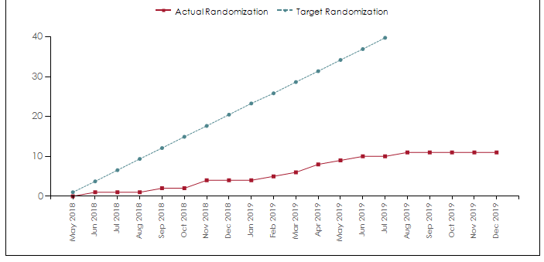
Actual vs. Target Randomization

Slide 3
Pro Tip: Reset your randomization password!
Reset your password PRIOR to the day of randomization: (https://reset.utahdcc.org/adssp/showLogin.cc)
Remember your password!

Slide 4
Amendment 3 Rationale
Clarify eligibility criteria
Streamline screening procedures and data collection
Increase enrollment

Slide 5
Efficacy Objectives
1. Evaluate the clinical improvement of all study participants at eight months of active shunting, using the primary outcome of gait velocity.
2. Evaluate the effect of shunting between active and placebo-controlled groups at four months using secondary clinical outcome measures as listed below.
3. Evaluate the clinical improvement of all study participants at eight months of active shunting using secondary clinical outcome measures.

Slide 6
Biomarker Objectives
4. Identify novel CSF biomarkers that differentiate patients with INPH from Alzheimer’s disease (AD) patients and other dementias, adjusting the typical cut-offs of traditional AD related biomarkers for altered volume of distribution when CSF is available from clinical testing.
5. Identify specific biomarkers associated with improved medium term (eight month outcomes) response to active shunting, enabling improved selection of participants in future trials.

Slide 7
Safety Objective
6. Compare adverse events (AEs) in the active versus placebo-controlled group at four months and at eight months of active shunting.

Slide 8
Study Design
Multicenter, randomized, blinded clinical trial
Delayed treatment paradigm
Interim analysis for safety after every 10 patients
Sample size: 40 participants

Slide 9
Randomization
Block randomization based on site
  Open shunt group: setting 4, 110 mm H₂O
  Closed shunt group: setting 8, >400 mm H₂O
At 4 months, all patients moved to open shunt group

Slide 10
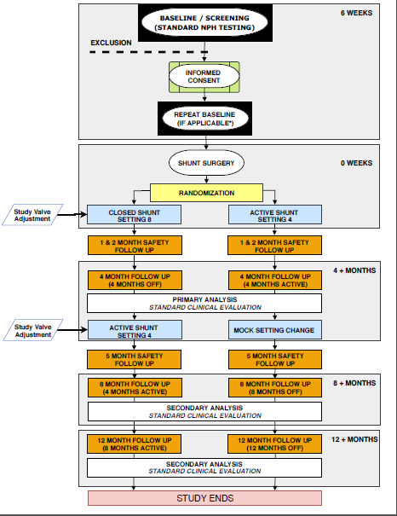
Study Design
Study workflow

Slide 11
Inclusion / Exclusion Criteria

Slide 12
Inclusion Criteria
  Age ≥ 60 years; and
  Diagnosis of INPH based on the Investigator’s clinical judgement based on criteria and testing as described in the INPH Guidelines; and
  Evans Ratio > 0.30
  One positive supplementary test whether infusion test, large volume LP or extended CSF drainage; and
  History or evidence of gait impairment (such as decreased step height or length, decreased speed, retropulsion as described in the INPH Guidelines2) ≥ 6 months.
  Sensory motor skills, communication skills and understanding to comply with the testing and reporting required in the PENS trial; and
  Able to give written informed consent, after being properly informed of the nature and risks of the study and prior to engaging in any study-related procedures.
  All patients meeting these inclusion criteria should be entered in OpenClinica.
  First data collection point!
Notes:
We did away with the log because everyone hated in, but now you need to let us know about upcoming patients and randomizations.

Slide 13
Exclusion Criteria
Unable to walk 10 meters with or without an assistive device; or
Baseline fastest gait velocity > 1 m/sec. and fastest gait velocity improvement is < 30% with or without an assistive device; or
Unable to return to the study center for follow up evaluation and shunt programming; or
Patient is not medically cleared for shunt surgery per local standards; or
Prior or existing shunts, endoscopic third ventriculostomy, or any previous surgical intervention for hydrocephalus; or
Secondary NPH. (Prior encephalitis, meningitis, subarachnoid hemorrhage, traumatic brain injury (including concussion) within 2 years or with brain injury or skull fracture on baseline imaging, brain abscess, brain tumor, obstructive hydrocephalus (including acquired aqueductal stenosis and carcinomatous meningitis)); or
Previous intracranial neurosurgical procedure; or
Current treatment with anticoagulation medications or expected to be on anti- coagulation medications in future based on clinician evaluation; or

Slide 14
Exclusion Criteria, cont.
Symptomatic cerebral or cerebellar infarction within 6 months from screening (asymptomatic lacunar infarctions are per- mitted); or
Hemiparesis, cerebellar signs or neurological deficits (e.g., cervical or lumbar myelopathy, previous stroke) precluding gait assessment; or
Diagnosis of Parkinsonian syndrome that, in the investigator’s judgement, will complicate the outcome evaluation; or
Diagnosis of schizophrenia or any psychiatric diagnosis (including depression) that, in the clinician’s judgment, will complicate the outcome evaluation (such as neuroplectic treatment for schizophrenia); or
Diagnosis of dementia disorder where the investigator considers cognition deficit limits participation in the study; or
Dementia, documented with a MoCA score of 18 or less, taken at standard initial evaluation; or
Conditions impairing gait that are considered to be unrelated to hydrocephalus, such as hemiparesis, spasticity, cerebellar ataxia or musculoskeletal and joint disease, which will interfere with gait assessment or the potential for gait improvement.

Slide 15
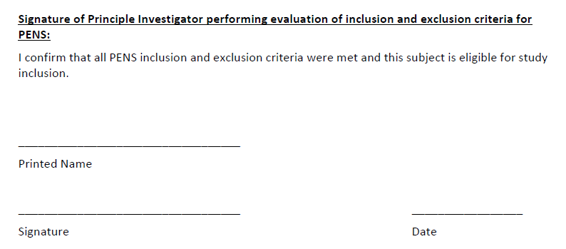
PI must sign the eligibility checklist!

Slide 16
Schedule of Study Events
- 14 days + 30 days
  Screening / Consenting / Enrollment
  Surgery
  One-Month Safety Follow-up
  Two-Month Safety Follow-up
  Four-Month Shunt Adjustment and Outcome Assessment
  Five-Month Safety Follow-up
  Eight-Month Outcome Assessment
  Twelve-Month Outcome Assessment

Slide 17
Screening / Enrollment
  Pre-screening for Eligibility
    Patients meeting all inclusion criteria must be added to the screening log
  Consenting
  Saliva Sample (when blood was not collected for the registry)
  Pre-Op Imaging
  Medical History
  Gait Velocity Testing
  MoCA (version 1)
  SDMT (standard)
  BDI-II
  mRS
  OAB-q Short Form Subscale
  SAEs

Slide 18
Randomization and Surgery
  RANDOMIZATION
  Neurosugeon (unblinded) uses internet-based randomization system
  Backup randomization envelopes must only be used if unable to access randomization system
  SURGERY
  Neurosurgeon sets valve according to randomization group
  Neurosurgeon records setting as “PENS study assigned setting” in the medical record.

Slide 19
One-Month Safety Follow-up
- 14 days + 30 days
  IN PERSON
  Post-op CT Scan (uploaded per AHCRN guidelines)
  BY PHONE
  Concomitant Medications
  AEs
  SAEs

Slide 20
Two-Month Safety Follow-up
- 14 days + 30 days
  BY PHONE
  Concomitant Medications
  SAEs

Slide 21
Four-Month Shunt Adjustment/Assessment
- 14 days + 30 days
  UNBLINDED SURGEON
  Shunt setting adjusted
  BLINDED ASSESSOR
  Gait Velocity Testing
  MoCA
  SDMT
  BDI-II
  Lawton ADL/IADL
  mRS
  OAB-q
  STUDY COORDINATOR
  Concomitant Medications
  SAEs/Neurological/Urological/Other AEs
WARNING: Unblinding Hazard
Care must be taken not to reveal randomization group to patient or family during this visit. Blinded assessor must not be present.

Slide 22
Five-Month Safety Follow-up
- 14 days + 30 days
  IN PERSON
  Post-op CT Scan (uploaded per AHCRN guidelines)
  BY PHONE
  Concomitant Medications
  AEs (neurologic, urologic)
  SAEs

Slide 23
Eight-Month Assessment
- 14 days + 30 days
  BLINDED ASSESSOR
  Gait Velocity Testing
  MoCA
  SDMT
  BDI-II
  Lawton ADL/IADL
  mRS
  OAB-q
  COORDINATOR
  Concomitant Medications
  SAEs/Neurological/Urological/Other AEs

Slide 24
Twelve-Month Assessment
- 14 days + 30 days
  BLINDED ASSESSOR
  Gait Velocity Testing
  MoCA
  SDMT
  BDI-II
  Lawton ADL/IADL
  mRS
  OAB-q
  COORDINATOR
  Concomitant Medications
  SAEs/Neurological/Urological/Other AEs

Slide 25
Roles and Responsibilities

Slide 26
Neurosurgeon responsibilities
  Participate in the consenting process
  Randomize participants
  Maintain blinding of assessor, blinded personnel, and patient
  Document “PENS study assigned setting” in the medical record
  Monitor patient for AEs that require medical intervention
  Report relevant AEs to PI (if not neurosurgeon) and study coordinator

Slide 27
Study coordinator responsibilities
  Remain blinded unless an AE requires a shunt adjustment for medical management
  Report data and events in OpenClinica
  Collect / send Saliva and CSF
  Upload images

Slide 28
Blinded assessor responsibilities
  Remain blinded throughout study
  Perform outcome assessments at study intervals
  Report outcome data to the study coordinator

Slide 29
Screening and Baseline assessment
Baseline requirements

Slide 30
How to assess gait velocity for screening?
  The best (fastest) of all three gait velocity tests will be used to determine eligibility
  How to calculate % improvement?
    (new speed – fastest original speed) * 100
        fastest original speed
  I.E if patient walk faster than 1 m/sec. in ANY of the trials or does not improve by 30% from the FASTEST trial, the patient is not eligible.

Slide 31
Who can perform the blinded assessments?
  Any AHCRN-trained assessor
  Does not need to be a study team member, but their certificates should be collected
  Every effort should be made that the SAME assessor assess the same patient at baseline and at all subsequent timepoints
  Blinded assessor must agree not to review the patient’s medical record while on study to avoid risk of unblinding

Slide 32
When should baseline assessments be done?
  Prior to or at least two weeks post LP or ELD
  No more than 6 weeks prior to randomization

Slide 33
When should baseline assessments be repeated prior to randomization?
  When screening assessments are completed by non-AHCRN trained personnel, an AHCRN-trained assessor must repeat the following after:
    Gait assessment
    MoCA (Version 1)
    SDMT
    Assessments should be repeated after patient signs consent and within 6 weeks of scheduled surgery.
  When surgery is delayed > 6 weeks from baseline assessments, repeat the following:
    Gait assessment

Slide 34
When should samples be collected?
CSF
  If patients consented to collection for the registry.
Saliva
  If patients did not have blood collected for the AHCRN registry AND consented to saliva collection for PENS.

Slide 35
AEs / SAEs
Reporting requirements

Slide 36
AEs / SAEs / Falls
  AEs
  New or worsening events
  Report for 30 days after shunt insertion and after shunt adjustment
  Falls
  Report falls on a separate log.
  Report throughout the trial
  SAEs
  Meeting the definition of Serious AE
  Report throughout the trial
  Report to the DCC within 24 hours
  Other AEs of Interest
  Neurological
  Urological
  Report throughout the trial

Slide 37
Serious Adverse Events
A serious adverse event (SAE) is an adverse event that:
results in death; or
is life-threatening (the patient was, in the view of the clinical site investigator, in
immediate danger of death from the event as it occurred); or
requires inpatient hospitalization or prolongs an existing hospitalization; or
results in persistent or significant disability or incapacity; or
results in congenital anomaly/birth defect); or
any other event that, based upon appropriate medical judgment, may jeopardize the subjects health and may require medical or surgical intervention to prevent one of the other outcomes listed in this definition.
Notes:
Outside medical records

Slide 38
THANK YOU

